Slide 1
Data structures
by Tomas Rolny

Slide 2
Definition
Data – collection of raw facts
Data structure is representation of the logical relationship existing between individual elements of data.
Data structure is a specialized format for organizing an storing data in memory that considers not only the elements stored but also their relationship to each other.

Slide 3
Introduction
Data structures affects the design of both structural and functional aspects of a program.
Program is : algorithm + data structure
We know that algorithm is step by step procedure to solve problem.

Slide 4
Classification of data structure
Data structure structure are normally divided into two categories
- Primitive data structures
- Non – Primitive Data Structures

Slide 5
Classification of data structure
Schema
Data structure
Primitive
Non - primitive
Interface
integer
Arrays
Class
Lists
float
Single dimension
Linear
Non - linear
character
Two dimension
Stack
Trees
boolean
Multi dimension
Queue
Graphs
long
Linked list
byte
double
short

Slide 6
Primitive data structures
-There are basic structure and directly operated upon by the machine instructions.
- Data structures that are directly operated upon the machine – level instructions are known as primitive data structures.
- Integer, Floating-point number, Character, constants, string constants, boolean, fall in this category.

Slide 7
Primitive data structures
Operations commonly used on data structure
- Create
- Selection
- Updating
- Destroy or Delete

Slide 8
Non – primitive data structure
- There are more sophisticated data structures.
- The Data structures that are derived from the primitive data structures are called Non-primitive data structure.

Slide 9
Non – primitive data structures
Linear data structures
Linear Data structures are kind of data structure that has homogeneous elements.
Linear data structures are very easy to implement, since the memory of the computer is also organized in a linear fashion.
Non-Linear Data structures
A Non-Linear Data structures is a data structure in which data item is connected to several other data items.
- The data elements are not arranged in a sequential structure.

Slide 10
Non –primitive data structures
The most commonly used operation on data structure are categorized into following types:
Insertion
Selection
Searching
Sorting
Merging
Destroy, Delete

Slide 11
Different between them
Primitive types are predefined in Java, Non-primitive types are created by the programmer and is not defined by Java.
Non Primitive types can be used to call methods to perform certain operations, while primitive types cannot.
A primitive type always has a value, whereas non-primitive types can be null.
A primitive type starts with a lowercase letter, while non-primitive types start with an uppercase letter.
The size of a primitive type depends on the data type, while non-primitive types have all the same size.

Slide 12
Descriptions of data structures, primitive examples

Slide 13
boolean data type
A boolean data type comprises of a bit of information and can store only true or false values. This data type is used to track true/false conditions.

Slide 14
byte data type
It is an 8-bit signed two’s complement integer. It stores whole numbers that lie between -128 to 127. A byte data type is helpful for saving memory in large amounts.

Slide 15
short data type
A short data type is greater than byte in terms of size and less than a integer. It stores the value that ranges from -32,768 to 32767. The default size of this data type: 2 bytes.

Slide 16
Descriptions Non – primitive data structures examples

Slide 17
Strings
String is a sequence of characters. But in Java, a string is an object that represents a sequence of characters. The java.lang.String class is used to create a string object.
What is a Java String? In Java, a string is an object that represents a sequence of characters or char values. The java.lang.String class is used to create a Java string object.
How to create string
By string literal : Java String literal is created by using double quotes. For Example: String s=“Welcome”;
By new keyword : Java String is created by using a keyword “new”. For example: String s=new String(“Welcome”); It creates two objects (in String pool and in heap) and one reference variable where the variable ‘s’ will refer to the object in the heap.

Slide 18
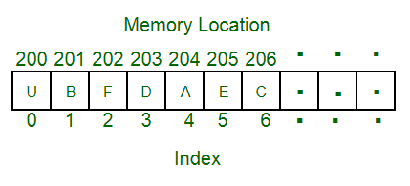
Arrays
Arrays in Java are homogeneous data structures implemented in Java as objects. Arrays store one or more values of a specific data type and provide indexed access to store the same. A specific element in an array is accessed by its index.
Obtaining an array is a two-step process.First, you must declare a variable of the desired array typeSecond, you must allocate the memory that will hold the array, using new, and assign it to the array variable

Slide 19
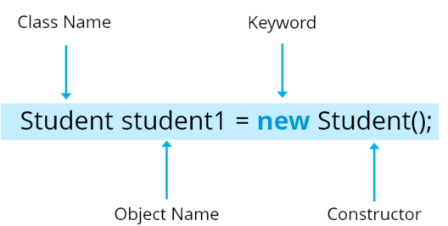
Classes
A class in Java is a blueprint which includes all your data. A class contains fields(variables) and methods to describe the behavior of an object.
An object is a major element in a class which has a state and behaviour. It is an instance of a class which can access your data.
Here, Student is your class name followed by the name of the object. Then there is a “new” keyword which is used to allocate memory. Finally, there is a call to the constructor. This call initializes the new object.

Slide 20
Memory allocation for data structures
Memory is divided on two parts stack and heap both are in RAM memory, primitive data types are in stack, non-primitives are in heap.
Memory
int a
John Doe
stack
heap
24
reference
student1

Slide 21
Thank you for your attention

